Slide 1
AKAGERA MOTORS RWANDA
1.1 PROJECT SUMARY
This project is about online selling and renting transport facilities (cars, motorbike, bicycles),
You can either buy or rent any available transport facility on our website,
All a user needs to do is to fill a small form that contains payment method and other few information about him/herself that will help us in delivering their order.
After a user creates an account(via sign up button), the provided information will be stored in our database.

Slide 2
1.2 problem statement
There are many problems that are commonly seen in African countries, one of those is to find a trust worth
Company to do business with or to make deal with, now it’s time to eradicate that,
In this project we first build up our trust by proving all the order as they were ordered and by the promised time,
Again some people try to buy things online but not all the commodities that are available on every platform,
Here we tried to address one of those problems that is about transport facilities.
We sell and rent transport facilities to help (improve) transport activities by providing vehicle near to the consumer.
And sometimes we order things online and we wait for them until we feel like we no longer need them, here is one
Of the main thing we consider, we deliver product at the promised time or less.

Slide 3
1.3 objective
Our objective is to address or solve all the problems that are stated and explained above
By building trust in our clients and by following our rules of delivery

Slide 4
1.4 project rationale
After we put in actions what we promise our customers, it will not be the same as it is now
Because people will trust the agreement we had and then they won’t feel fooled.
And it’s easy to buy things online because it won’t take you time to go to the office or stock to see
The product.

Slide 5
2.1 DATA COLLECTION METHODOLOGY
I experienced it.
I knew the problem when I bought shoes on kikuu and I liked them
I saw them and I liked them but by the time they delivered them I found that I was not my size.
Since than I no longer trust online things.

Slide 6
2.2.1 hardware tools to be used
I need computer to go on with the project.
2.2.2 software tools to be used
XAAMP
BROWSER
VISUAL STUDIO CODE

Slide 7
3.SYSTEM ANALYSIS AND DESIGN
3.1 requirement specification
3.1.1 functional requirement
Here a user is requested to sign in once he or she entered or visited our website at the
Fist time.
The after he or he signs in his or her information get kept in our database
And by the second time he comes he is not requested to sign in again but
He is asked to log in with some of the credentials he used to sign in.

Slide 8
3.1.2 data requirement
ERD example
product
makes
manufacturer
Buy s
customer

Slide 9
3.1.3 main actors in the system
Customer
Manager
3.1.4 security management
On the login and sign in there is password bar

Slide 10
3.1.5 non-functional requirements
The system works very well as long as a user provides all the requirements correctly.
The system is reliable since you create your own account with you own password.
The system is easily accessible since it will be online filling and using.

Slide 11
32.1 system overall architecture
home
Products types
contacts
help
Product list

Slide 12
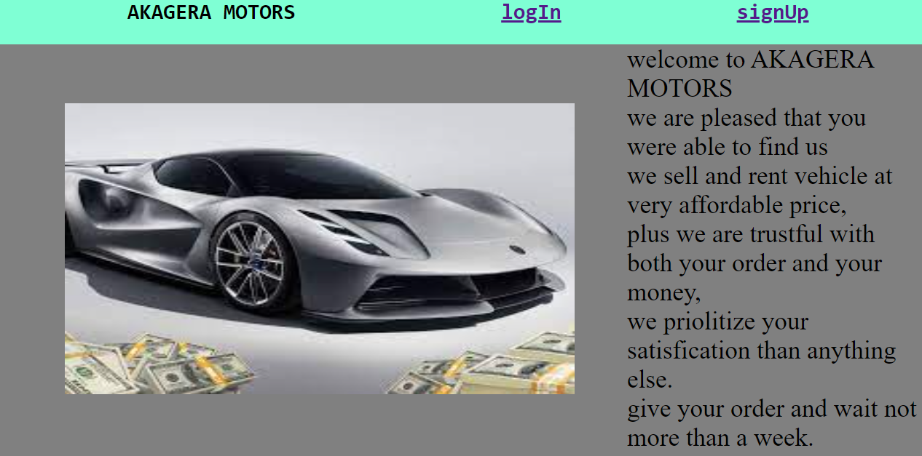
4.1 LANDING PAGE

Slide 13
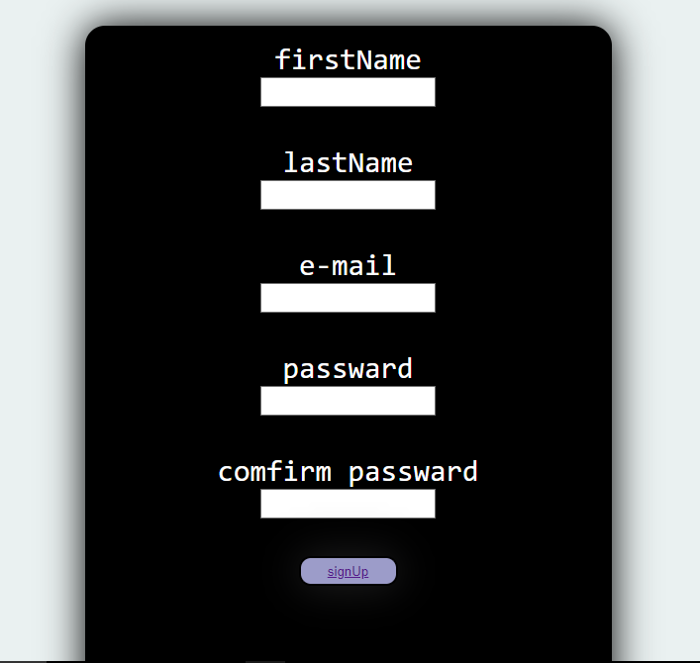
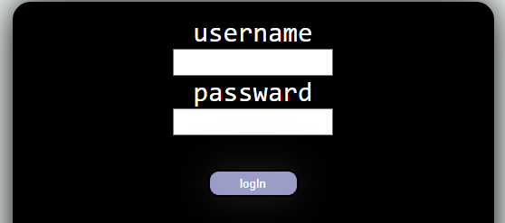
4.2 SIGN IN AND LOGIN PAGES
LOGIN
SIGN IN

Slide 14
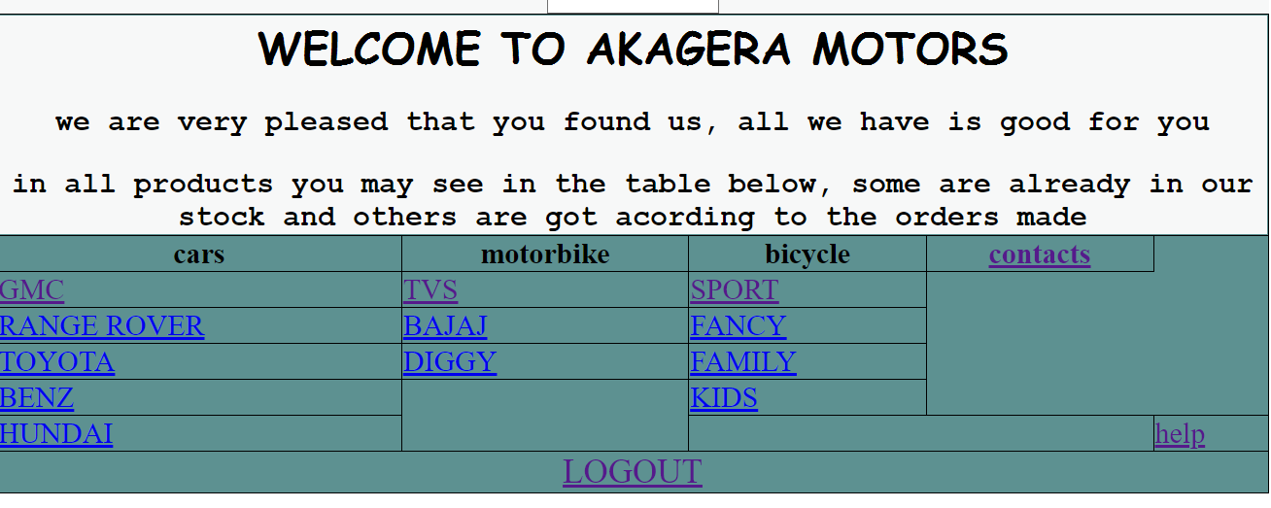
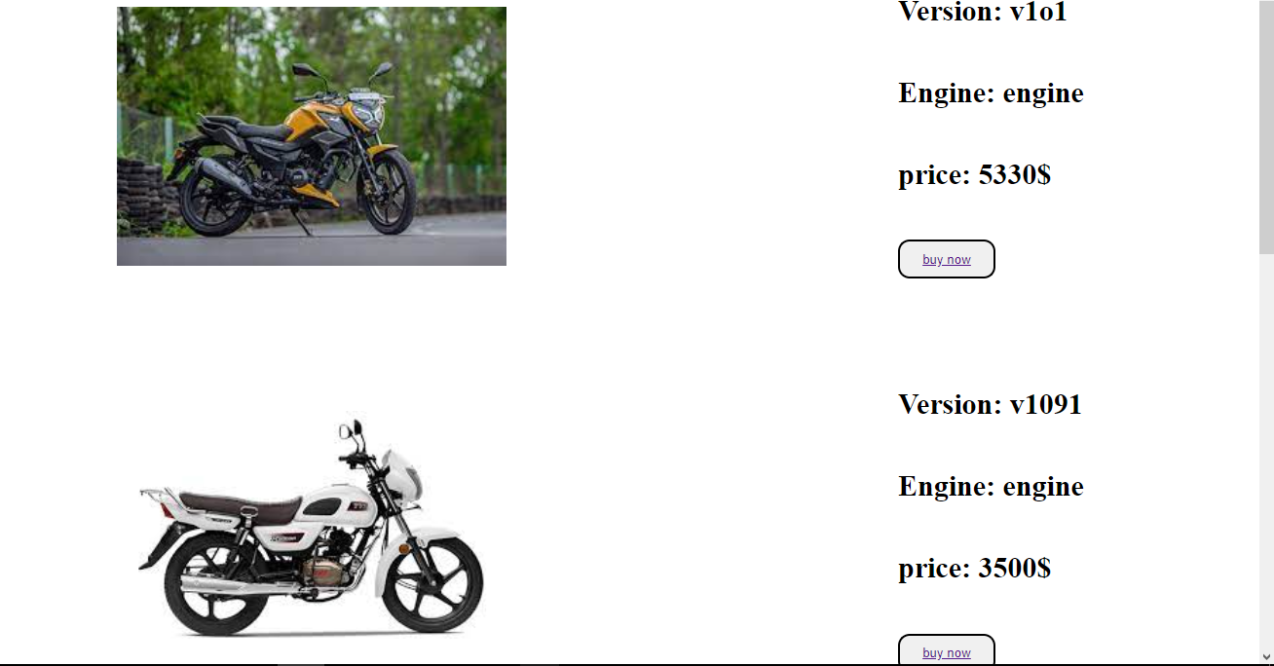
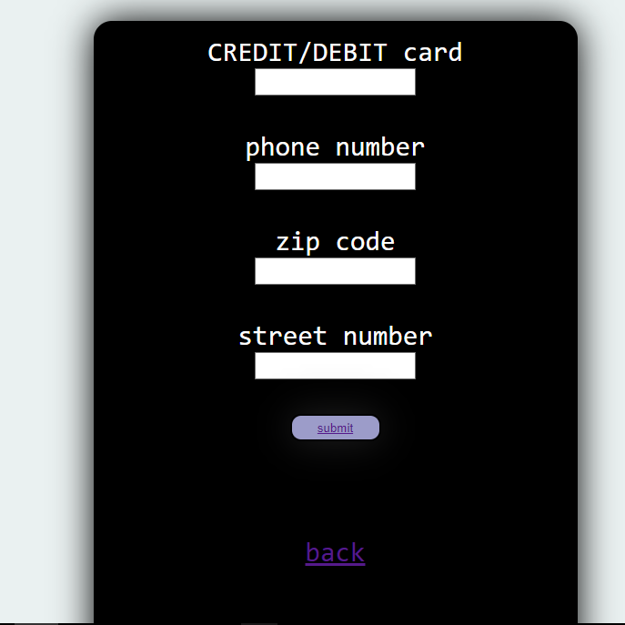
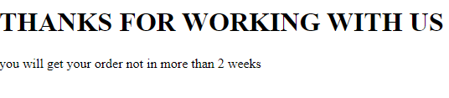
PRODUCT LIST
PRODUCT EXAMPLE
AFTER YOU ORDER
BUYING FORM

Slide 15
5. CONCLUSION
This project will help overcomes problems that are stated above in efficient manner by providing what is missing today.
According to what I wanted to do about this project, I can say that at this point I managed to do at least 75% of the whole project.
6 RECOMMANDATION
I have learned that managing to make a whole website is not easy as I thought I was, (this is my first web to make if I can say),
ought it was HTML job to build up a website but no man can stand alone, I have seen.
I have learned that many other programing languages are used to build an efficient website.

Slide 16
1. I would recommend other students to learn all the programming languages earlier
And try to master them as hard as they can
2. I would recommend computer and software department to try to bring this module down in lever 1
So that students would go with it from a fare

